Slide 1
Customer Feedback Analysis at Scale
Florian Ernst - 2024

Slide 2
Introduction
About me:
Name: Florian Ernst (@mySugr for 8 years)
(iOS) Mobile Developer -> Data Engineer -> Security Eng.
About what I'm building:
Is in an early alpha phase & under development.
Result of many weekends talking to Large Language Models.
Still in POC phase.

Slide 3
Agenda
The Problem
The Goal
The Solution?
Feature Overview
How does it work?
Miscellaneous
Demo Time
Feel free to raise your hand at any time for questions ✋

Slide 4
The Problem
Analyzing large volumes of diverse customer feedback is resource-intensive.
Manual analysis methods are slow, biased, and miss contextual nuances.
Delayed feedback processing hinders timely action on emerging issues.
Tracking metrics like downloads and ratings alone fails to capture the full spectrum of customer sentiment and insights.

Slide 5
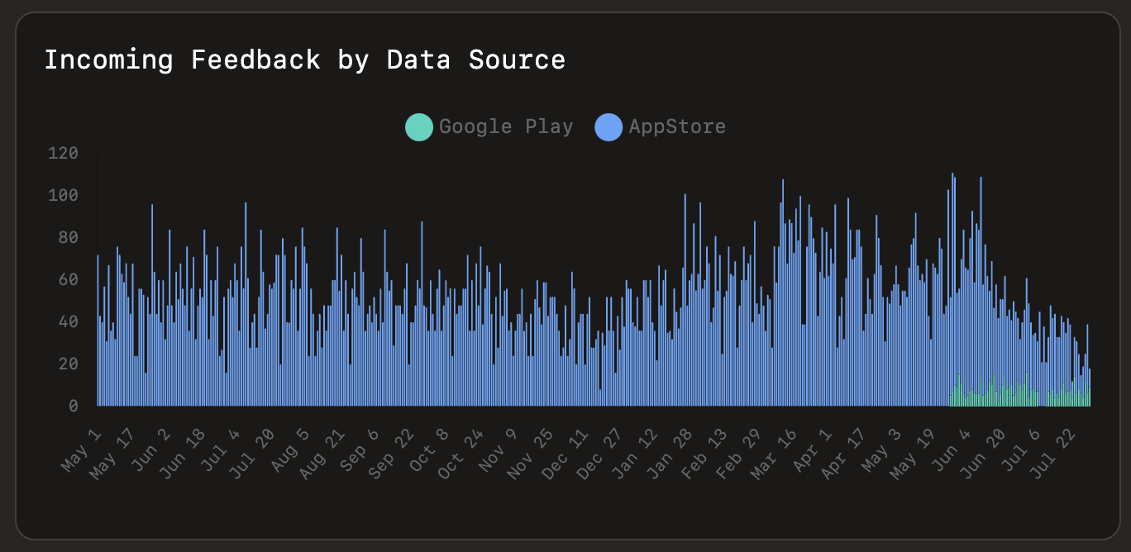

Slide 6
The Goal
Making sense of customer feedback.
Providing tools to arrive at actionable insights.
Summaries, Reports, Dashboards, Search Engines..
Identifying in-the-wild issues early.
Help with the detection of special information in customer feedback (safety relevant).
Use the same approach to identify weaknesses and areas for improvement in competitor products.

Slide 7
The Solution?
LLMs are trained on trillions of tokens of human written text, which makes them good at:
Natural Language Processing
Sentiment detection
Context understanding
Filtering of noise
Extraction of features
Conclusion: Use LLMs to analyse the feedback, categorize it & create summaries and insights.

Slide 8
Feature Overview

Slide 9
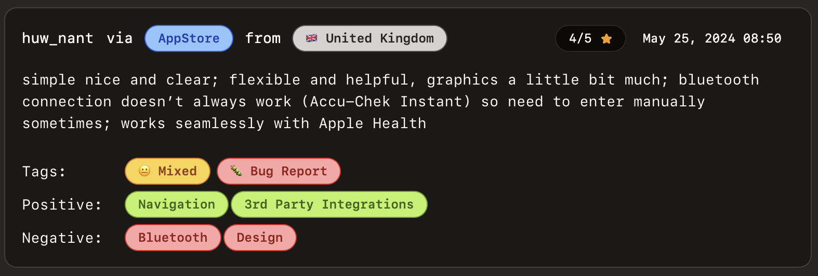
Default Feature Extraction
Positive & Negative Keywords
Issues / Bugs
Feature Requests
Questions
Sentiment

Slide 10
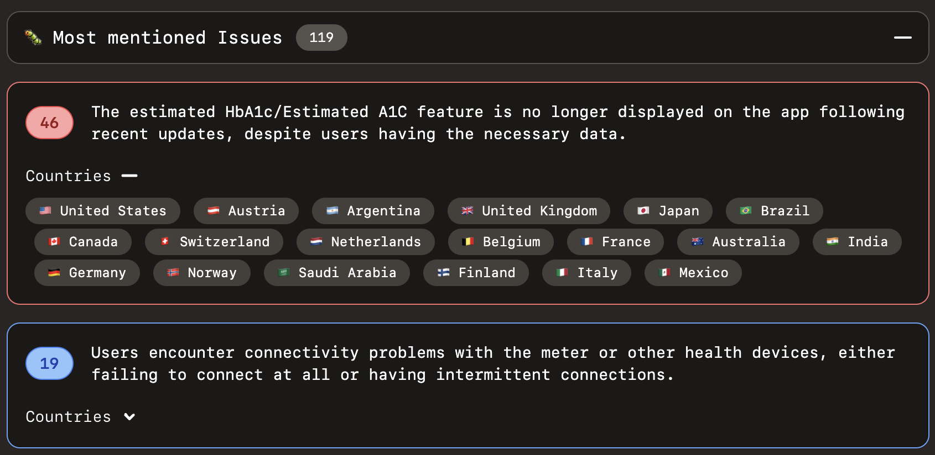
Feedback Summarization

Slide 11
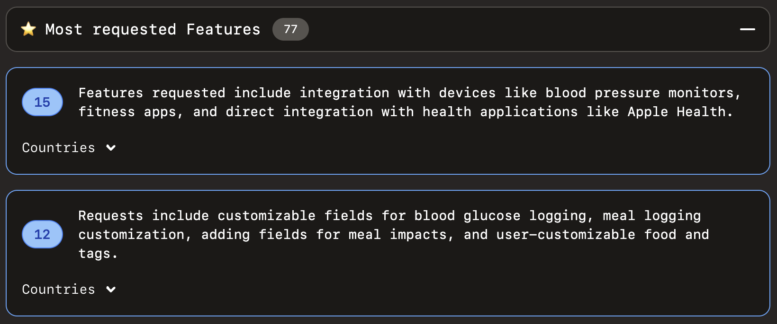
Feedback Summarization

Slide 12
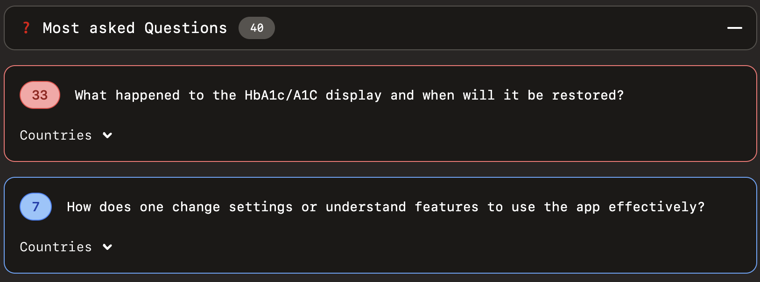
Feedback Summarization

Slide 13
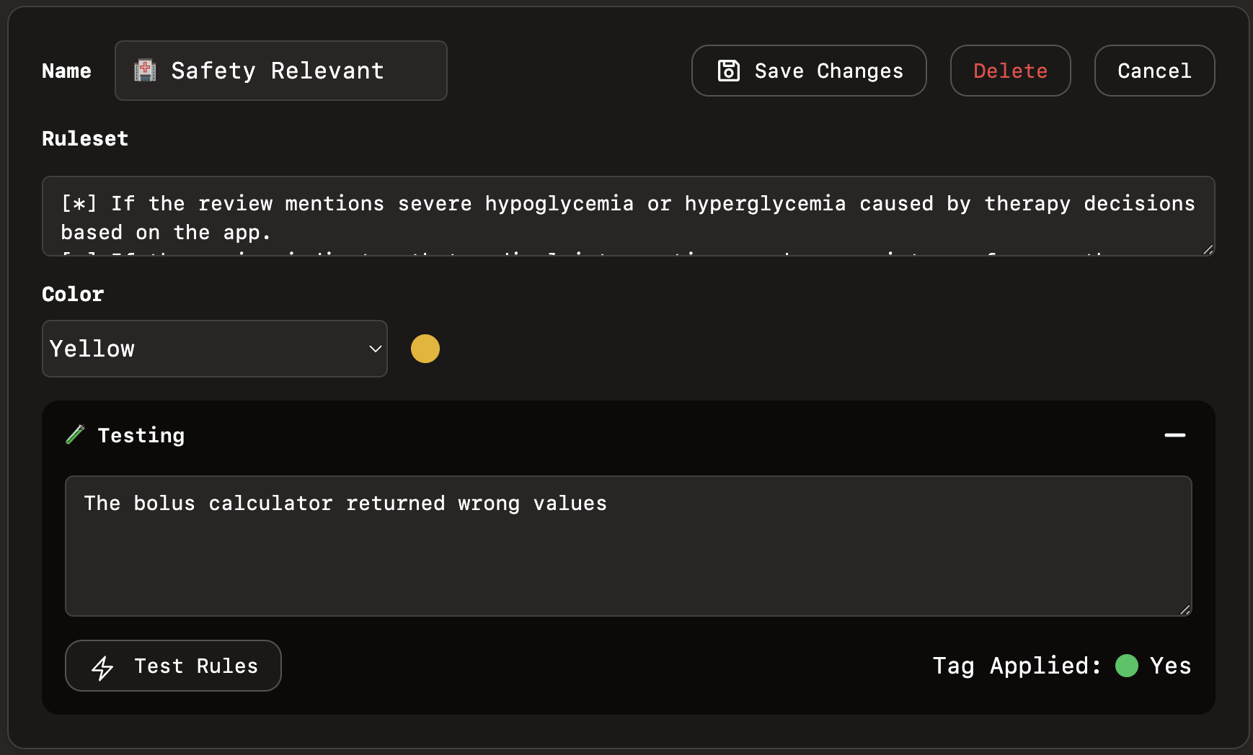
Custom Tags

Slide 14
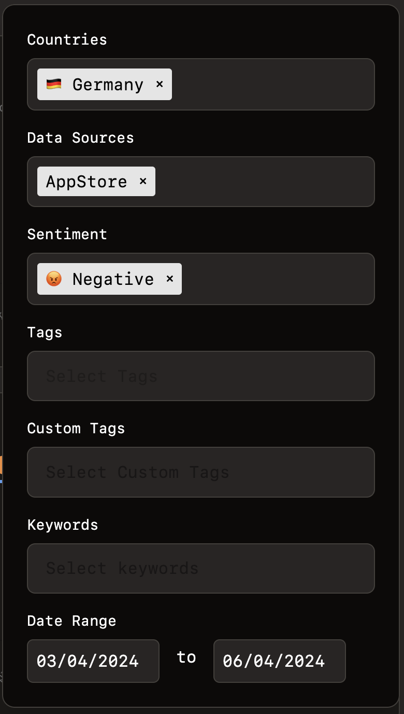
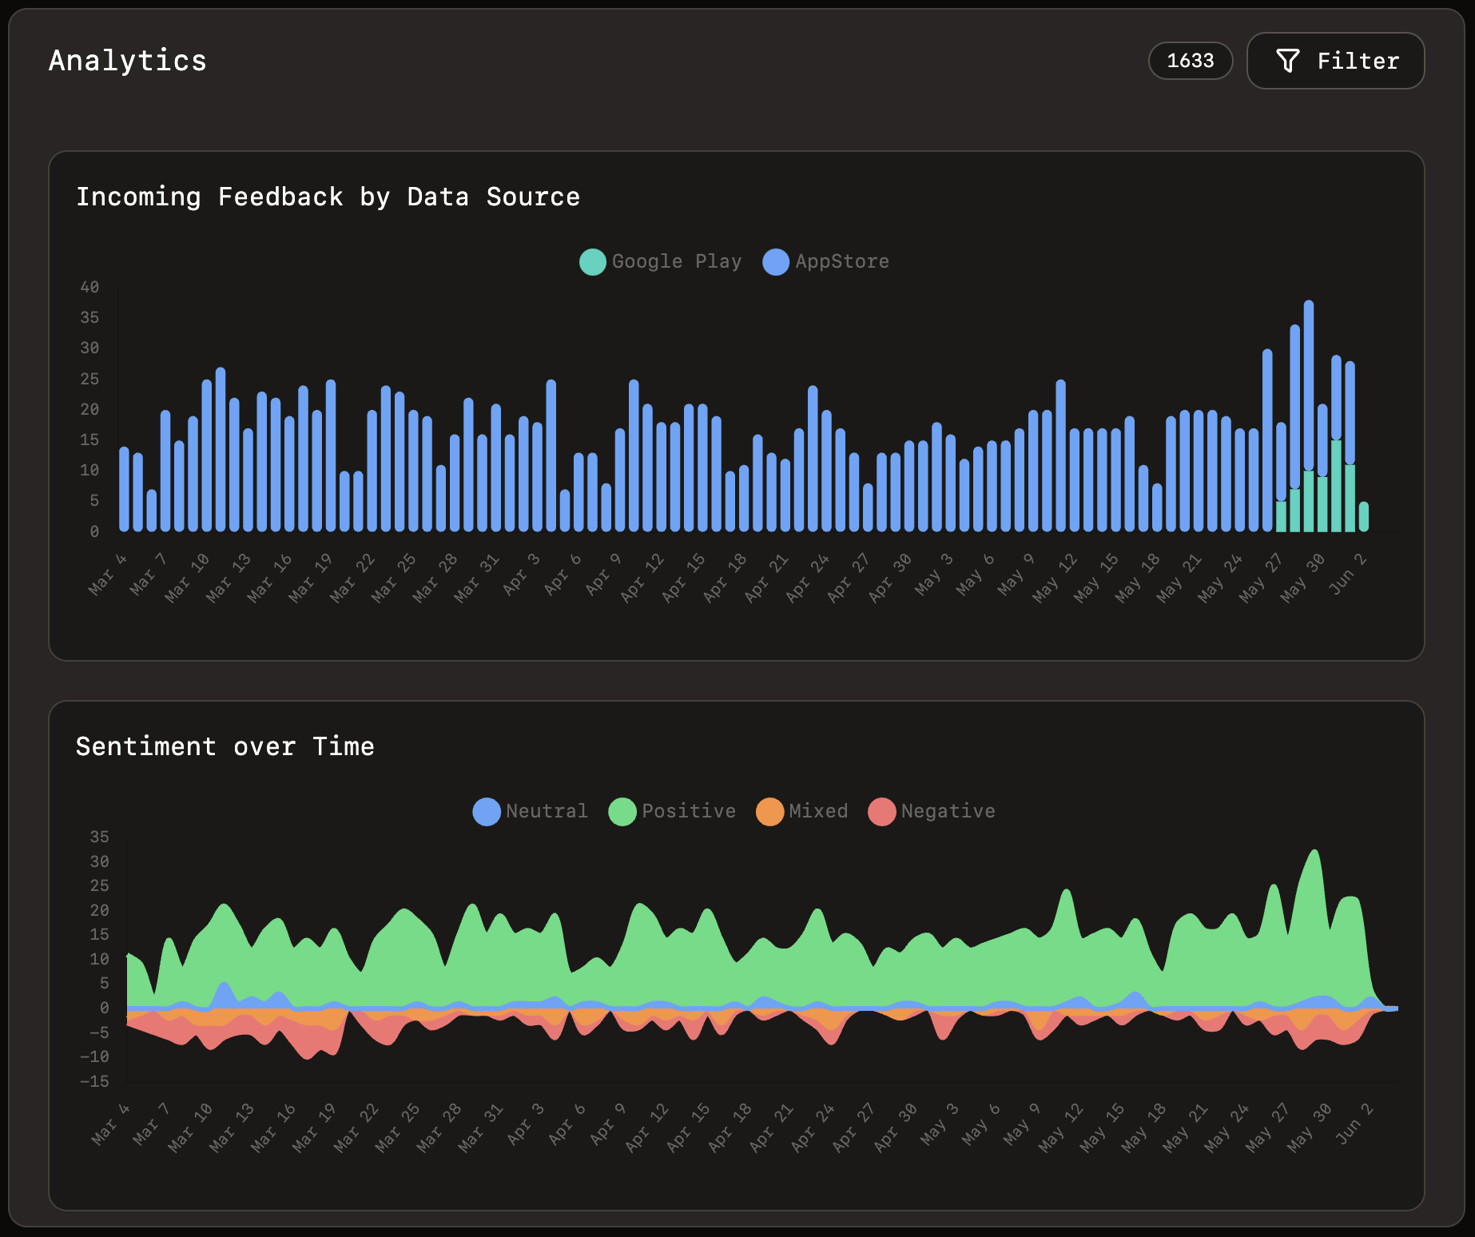
Analytics & Filters

Slide 15
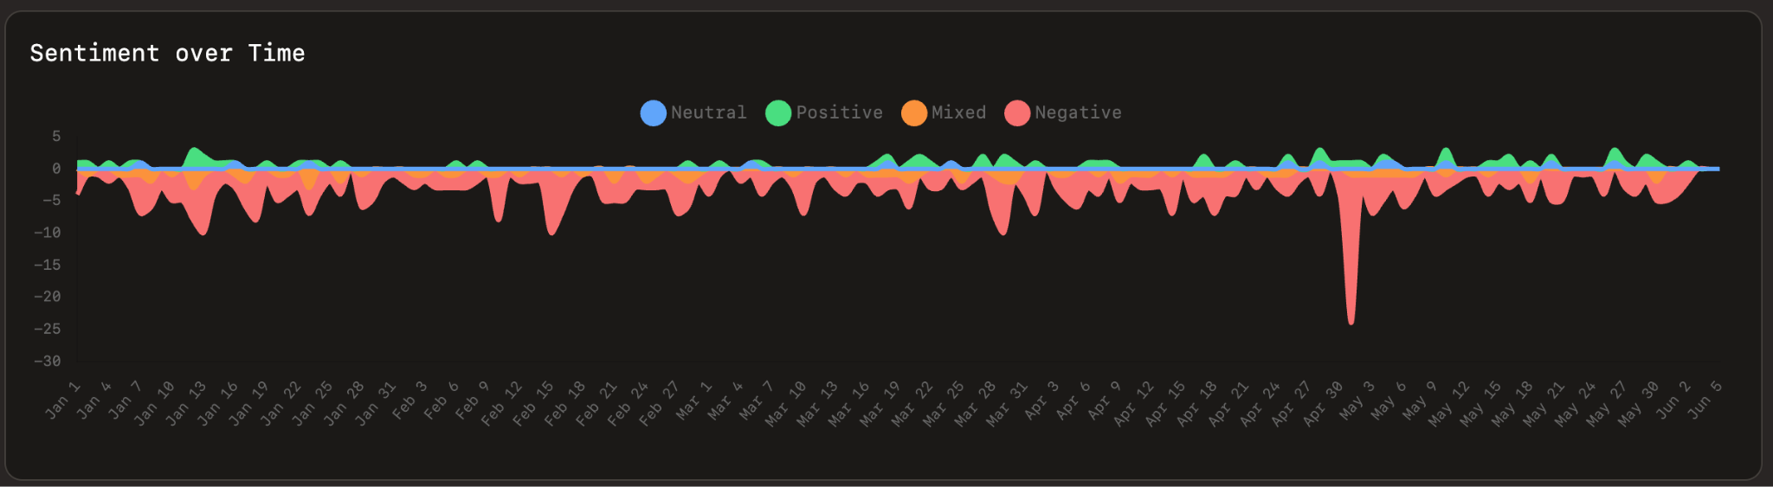
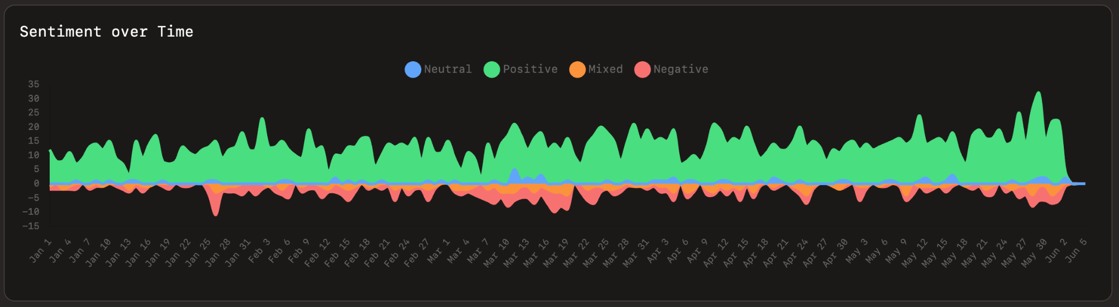

Slide 16
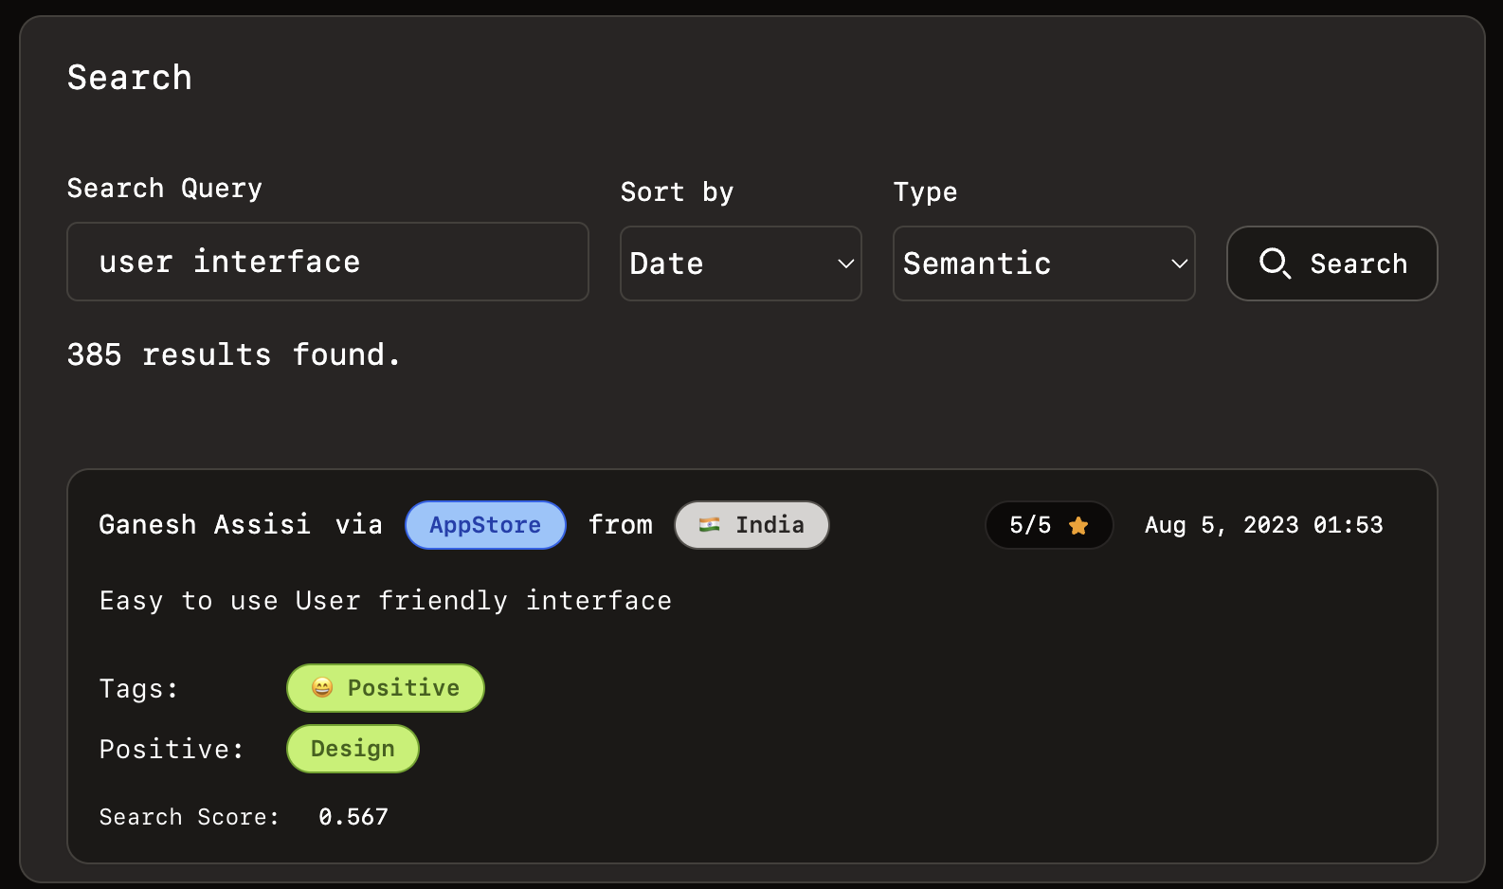
Full Text & Semantic search

Slide 17
Supported Data Sources
Apple's AppStore (API / Scraper)
Google Play (API / CSV / Scraper)
Rest API
Reddit Live Monitoring
More to come…

Slide 18
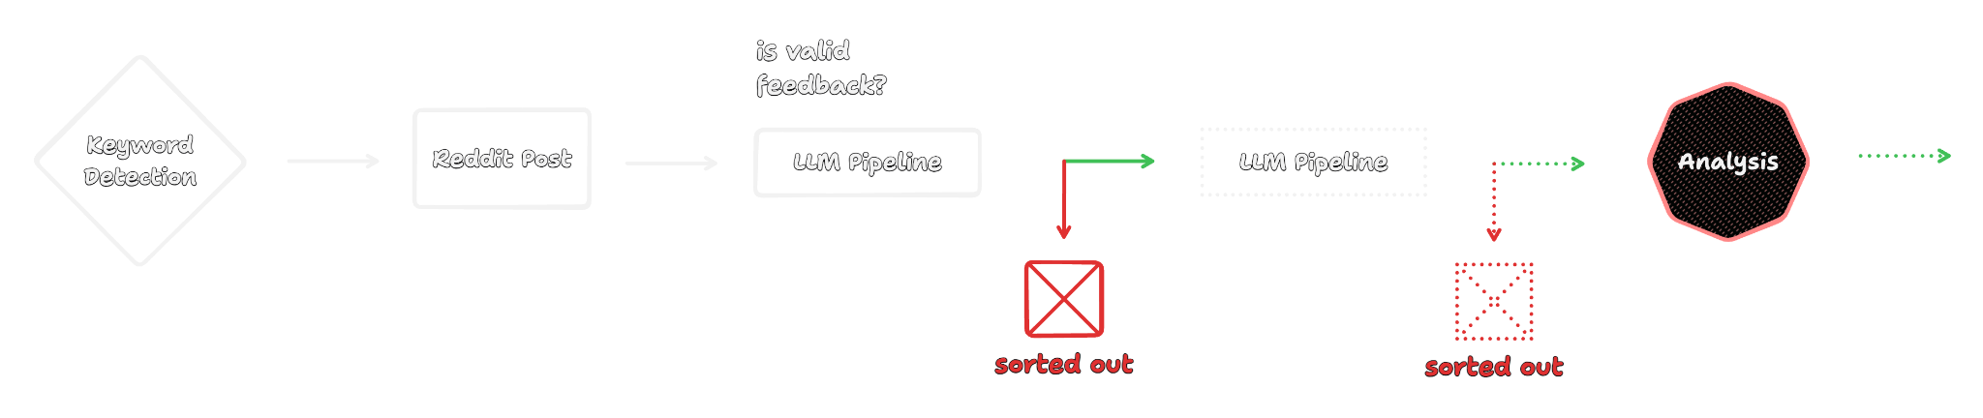
LLM powered Web Scraping

Slide 19
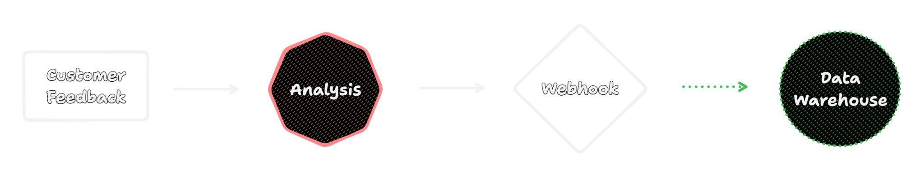
Webhook Mode
In this mode, a webhook (JSON POST) is called once the analysis is finished and no data is stored in the database.

Slide 20
How does it work?

Slide 21
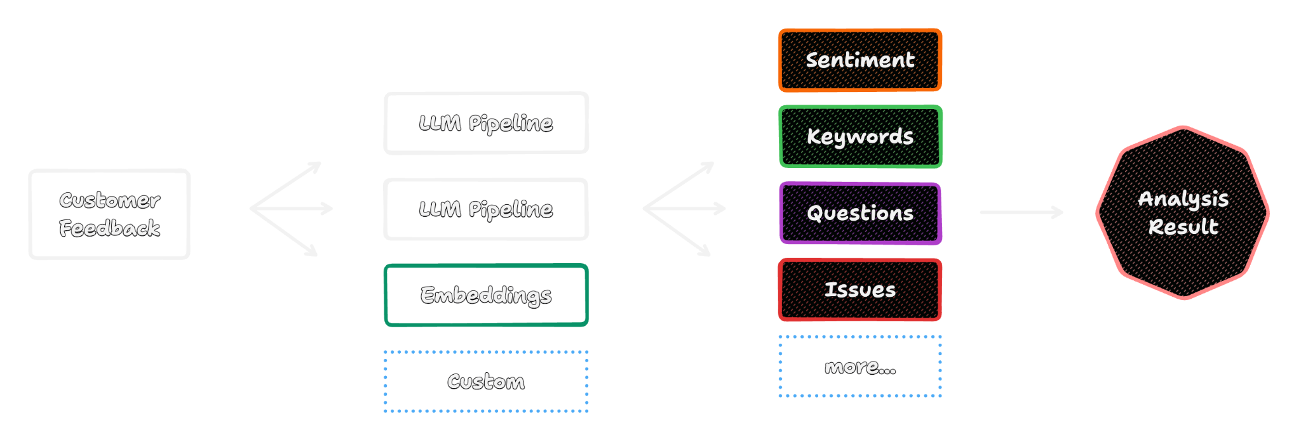
Step 1 - Analysing the Feedback

Slide 22
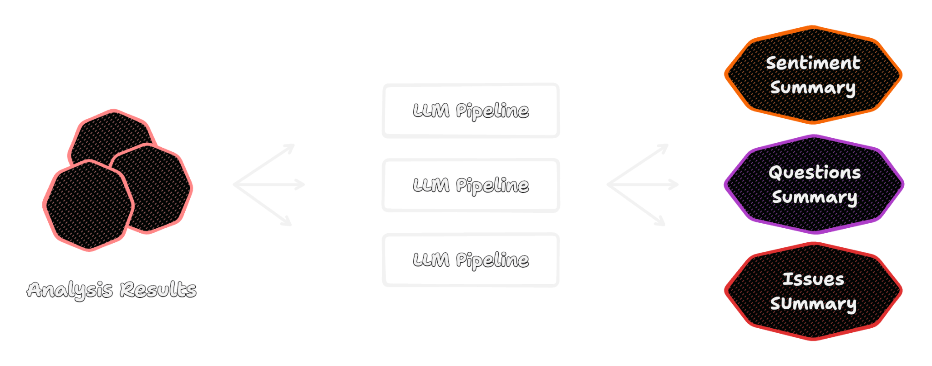
Step 2 - Creating Internal Summaries

Slide 23
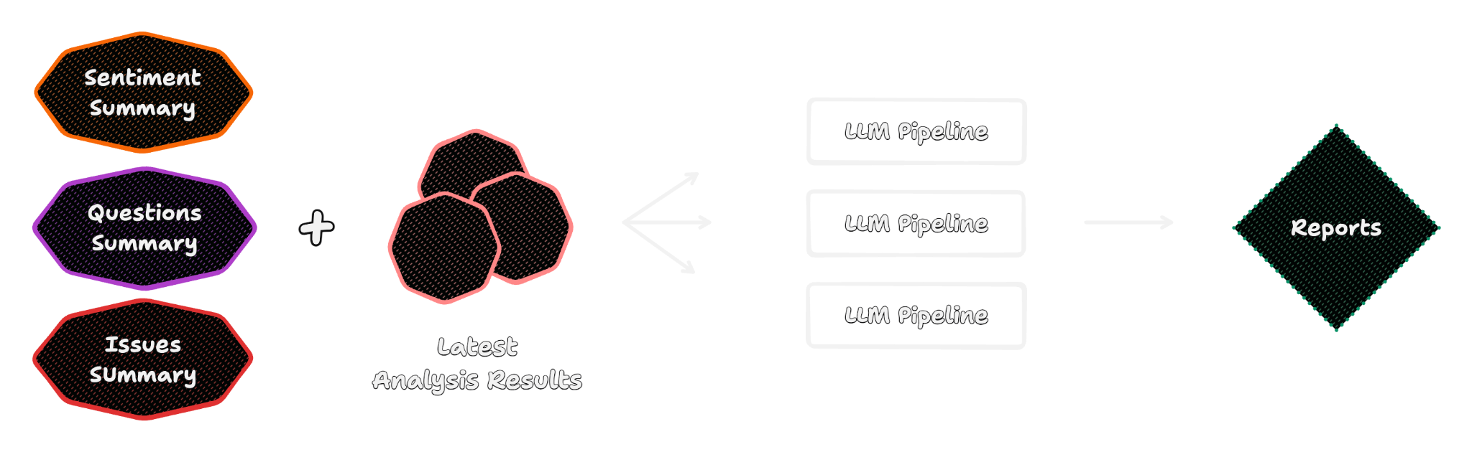
Step 3 - Creating Reports

Slide 24
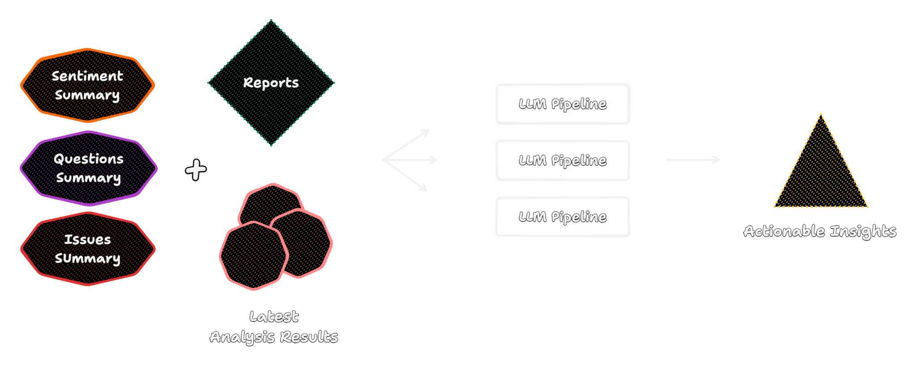
Step 4 - Creating Insights

Slide 25
Speed, Models & more
Mix of Anthropic Claude, GPT-4o, llama3
Pipelines highly configurable.
Written in Go, HTMX & Tailwind.
Heavy lifting is outsourced to Serverless GPUs and LLM API providers.
Could probably be moved completely on-premise.
Demo runs on a 3.49 EUR / Month Server

Slide 26
Roadmap & Future Outlook
More Data Sources
Dashboards
More analysis types
Mark app as competitor to run different pipelines
- ChatGPT like interface
- Cross App comparisons
This is the worst AI will ever be.

Slide 27
Demo Time

